Slide 1
Physical Security
Presented By:
J. Nicole McDargh, MBA, JD, CPP

Slide 2

Domain 5 – Physical Security (25%)
Part 1: Physical Protection System Goals and Objectives (Ch1)
Part 2: Physical Protection System Design (Ch2-8)
Part 3: Analysis (Ch11)
Part 4: Implementation (Ch 12)
Protection of Assets Manual - (Protection of Assets)

Slide 3
We Will Review…
Facility Surveys
Select, Implement and Manage Physical Security Strategies
Assess the effectiveness of the security measures
Notes:
2 hours divided into three tasks – that gives us 40 minutes per task

Slide 4
More Details
Facility Surveys
Security Protection Equipment and Personnel
Survey Techniques
Building Plans, drawings and schematics
Risk Assessment Techniques
Gap Analysis
Select, Implement and Manage Physical Security Strategies
Fundamentals of security system design
Countermeasures
Budgetary projection development process
Bid package development and evaluation process
Vendor qualification and selection process
Final acceptance techniques
Cost Benefit Analysis Techniques
Labor-Technology Relationship
Assess the effectiveness of the security measures
Protection of personnel, technology and processes
Audit and testing techniques
Preventive and corrective maintenance for systems
Notes:
2 hours divided into three tasks – that gives us 40 minutes per task

Slide 5



Notes
CPP Exam Guidelines
Notable / Tip
Big Picture

Slide 6
Framework
Goals
Problem Definition
Design Principles
Design
Detection
Deterrence
Analysis / Implementation
Audits
Delay
Response
ROI
Notes:
We begin our journey by understanding the fundamentals of the physical security structure and program.
Our goal is to provide Physical Asset Protection (PAP)
Any program needs to fundamentally: 1) provide protection in depth, 2) consider the minimum consequence of component failure, 3) provide balanced protection…concepts which will be discuss more fully in the Principles and Practices section.
This graphic illustrates by way of a nesting diagram how the goals of a pps holds the design and the effectuation of the program.
First we need to understand the goals – that is 1) what is the problem the system is trying to solve and 2) ensuring the good and appropriate use of sound design principles in finding the solution.
What are those design principles? First a PPS should Deter, Delay, Detect and respond to a problem –
Once the design has been built we must ensure that it is audited (through the various continual improvement modules which we will discuss in the Security principles and practices module) and measure the ROI (through methods we will discuss in the Business Principles module)

Slide 7
Facility Surveys: 33% of content
Security Protection Equipment and Personnel
Survey Techniques
Building Plans, drawings and schematics
Risk Assessment Techniques
Gap Analysis
Notes:
2 hours divided into three tasks – that gives us 40 minutes per task
This task has 5 sub tasks which means 8 minutes per sub task – as such we will not do a full review of the equipment. Please review the POA for details on the physical security equipment
However, in order to be able to conduct a survey you have to have an understanding of Security equipment and security personnel. You have to understand the strategy and tactics of conducting the survey. You must be able to understand a building plan with its drawings and schematics, you must then be able to conduct a risk assessment and a gap analysis.

Slide 8
Security Equipment and People
Sensors
Alarms
Video Surveillance
Doors
Locks
Windows
Fences
Barriers
Guards (response force)
First Responders
Internal vs External Response forces
Integration in order to achieve a security system
Notes:
Security aids can be grouped into various categories and includes a variety of equipment, specialized or construction and people. Lets take a quick look at each category.

Slide 9
Sensors
Passive or Active
Volumetric or Line detection
Application
Covert or Visible
Line of Sight-Sensor or Terrain Following
Notes:
Important concepts about sensors:
Probability of Detection – perfect is 1 (100%) – that doesn’t happen. (PD)
Confidence Level – 90% 95%
The PD varies according to weather, hardware design, sensitivity adjustment, condition of the equipment. The security designer needs to figure out what her tolerance level is in order to select the right configuration and adjustments
Nuisance Alarm Rates (NAR) – nuisance alarms are those which are triggered by anything other than an intrusion. Ideal this should be 0, but unlikely for the same reasons as the PD.
The engineer should design with the False Alarm Rate in mind.
Ideally you would set clear tolerance such as a PD of .9 with a FAR of no more than one per day per zone.
Vulnerability to defeat – you can defeat via bypass (whereby the bad guy goes around the detection zone) or a spoof (whereby the bad guy is able to get pass the detection zone without being noticed
The sensors should be operated according to their specs (weather) and are best if they are UL certified – understand their limiations. For example if it’s line of site you can’t use it in places where there a lots of trees or vehicle movement. If the weather is variable you probably wouldn’t want to use an ultrasound.
Other factors to keep in mind are the maturity of the sensor (long in use or is it a test?)
Design consideration : they are best used in combination with another technogloy in order to create a protection in depth. Use sensors which are complementary (different strengths and weakeness)
Keep them tested, maintained, find tamper resistant versions, keep in mind the environmental factors, surge protection (lighting),
Passive v active – refers to the mechanism which is required for an event to be triggered. Active sensors send out a signal whereas passive sensors wait to receive a signal. A motion detector

Slide 10
Camera Systems: Types
Analog
IP
Infrared
Thermal
Notes:
Things to keep in mind about video surveillance system:
They will go obsolete
Make sure it’s designed to meet the need – figure out the need, then apply the correct tool
Think about future expansion
The goal of the system is for one of three things
To obtain visual information about something that is happening
To obtain visual information about something that has happened
To deter undesirable activities
There are different types of cameras and you should use the right type!

Slide 11
Camera Systems: Field of View
Target
Activity
Purpose
Notes:
Field of view helps to determine the right lenses…but you need to go a bit further
Do you want to SEE (recognize) your subject (man, woman, race) or do you want to be able to identify him?
Do you want to capture a particular activity (this will determine the frame rate
Will you need it to actively record, alert, combine with a sensor, send alerts or other data (License Plates)
Types of lenses to consider: wide-angle (short wide), standard lens, telephoto (long narrow), zoom (moves, tracks, auto focus), varifocal (small mount of zoom range, needs to be refocused)

Slide 12
Camera Systems: Resolution
5 Px/ft
General: clothing & colors not distinguishable
7 Px/ft
Monitor: general human or vehicles, traffic flows
11 Px/ft
Detect: but not identified
18 Px/ft
Observe: clothing & colors start to become distinctive
35Px/ft
Recognize
ID known individuals
46 Px/ft
Subject ID beyond a shadow of a doubt
70 Px/ft
License plate
88 Px/ft
Facial recognition
Notes:
In general you will need to determine your tolerance for subject identification, action identification and scene identification.
This will allow the designer to select the right type of camera, lenses and angle of view.

Slide 13
Lights: Basics
The two most important parameters of a lighting system for CCTV: Intensity and Evenness
The quantity of light emitted by a lamp is measured in lumens.
Minimum Intensity
Evenness of Illumination
Notes:
Illuminances is the concentration of light over a particular area:
Illuminance is measured in LUX (which is the lumens per square meter) or in Foot Candles (number of lumens per square foot)
Reflectance: percentage of light reflected from the scene
Intensity must be great enough to provide the necessary light for the cameras selected.
Evenness is the light to dark ratio.
Lighting is vital to proper Surveillance system deployment.

Slide 14
Lights: Specific Applications
A general rule for lighting level is:
0.5 fc for detection
1.0 fc for recognition,
2.0 fc for identification
5 fc w/ uniformity Rate of 4:1 =Parking structures
(Mcghee, 1988)
Notes:
Interesting to note that tone and colo temperature has a significant effect on mood and amibance. So, keep lighting in mind for CPTED applications.
Accurate color renditions are also effected by the type of light – this is measured by the Color Rendition Index (CRI) – with 100 percent being daylight. Light sources with low CRI are color distorting.

Slide 15
Access Control
Entry Control: Physical equipment used to control movement of people or material into an area. Performance
Access Control: the process of managing databases or other records and determining the parameters of authorized entry (who, what, where, when).

Slide 16
Alarm Communication and Display
AC&D – moves alarm information to a central point for an operator to act on
Wireless, Cable
Various subsystems (video, sensor)
Loop, point to point and multiplex
Notes:
Systems must be designed to withstand environmental pressures
Wireless: radio, microwave, cellular, satellite, laser
Wired – optical, coax, cat 5/6
Issues: line protection, masking, encoding
Most important! Where did the alarm occur, what /who caused the alarm, when did the alarm happen
There are three types of transmission installation types: loop (less common, better for small installation– point to point (device sends signal directly back to control center) and multiplex (multiple devices can transmit at the same time
Keep in mind the ergonomics about the console at which the operator sits.

Slide 17
Entry Control
Personnel Entry Control
Locks
Access Control
Notes:
Managing the flow of people can be done through PINS, Tokens such as: IDs, Credential Card or Bio verifications (eye, hand, finger, handwriting). Contraband detection may be part of this with manual search, metal detectors, package searches, explosive detection,
Most common element of a system: they can be Mechanical or electrical. They are vulnerably to attack by force, by picking (surreptitious attack), or by fakes. Be aware of master keys.
Electric locks: fail safe – unlock when there is a failure. Fail secure – lock when there is an issue (cannot be used unless free egress is available)
Design for locks: think of the totality (heavy lock, light door, doesn’t make sense) consider the different levels of security needed, the likelihood that those levels will change, how many users will require access, the possibility that the access devices will be compromised
Design for access control – people will try to circumvent these by forging a credential, or guessing at it (or some other technical attack)

Slide 18
Barriers: Access Delay
Principle of Balanced Design: each aspect of barrier has an equal delay.
The more an adversary is delayed, the more time security staff have to assess the situation and send a response force.
Passive Barriers – doors, walls, floors, locks, vents, ducts, and fences
Personnel – security officers, receptionist, concierge
Dispensable Barriers – chemical fogs and smokes, foams, irritants
Notes:
The idea is to blend and use all types of barriers
Think of the weakest part of the barrier

Slide 19
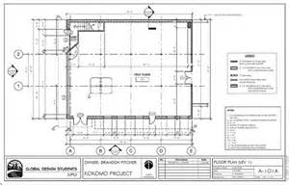
Building Drawings
Plans
Top-down, map-like view of an area
Symbols set for manual drafting is issued by the ASTM International in Standard Practice for Security Engineering Symbols
Notes:
The idea is to reduce confusion, but the specifications always take precedence.
Should provide a view of location of security devices by type

Slide 20
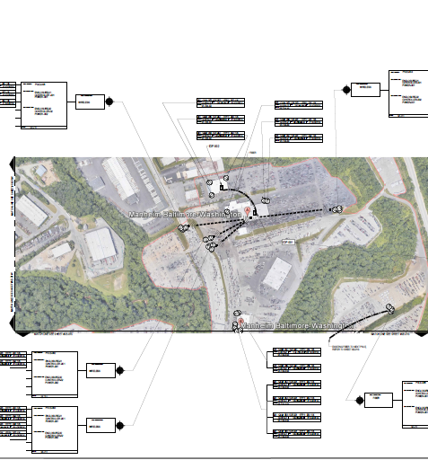
System Designs
Location and Type of Cameras
Location of Servers
WAPs
Fiber Runs
Notes:
It is important that the placement is clear as in any required interconnectivity.

Slide 21
Risk Assessment

Slide 22
What is Risk
Threat + Consequence + Vulnerability = Risk
Threat = adversary capability, equipment, motivation, intent and the likelihood of the attack
Likelihood of the attack can be based on frequency or probability
Consequence = undesirable outcome
Vulnerability = PPS weakness that can be exploited
Notes:
PPS – physical protection system
We will address this in more detail in the Security Principles and Practices

Slide 23
Understanding the Risk
Risk Assessment
Risk Analysis
Vulnerability Assessment
Gap Analysis
Security Survey
Security Survey
Notes:
The overall risk assessment is built on a number of other components.
The risk analysis – takes a look at what risks exist in a facility. This in itself has the component of looking at the risk from the asset perspective, and from the current security posture and system view.
When looking at the security components, systems procedures etc we are conducting a SECURITY SURVEY.
Vulnerability – is what risks may actually impact the organization/entity you are trying to protect
Gap – where threats exists that aren’t covered by the PPS
You will want to review the Physical Security Standard ANSI/ASIS PAP 1.2012 which addresses Physical Asset Protection

Slide 24
Risk Analysis Big picture
What can go wrong?
What is the likelihood that it will happen?
What is the consequence?

Slide 25
Risk Analysis: Consequence Criteria
Undesired Consequence | Low | Medium | High
Loss of life | 1-10 | 11-50 | >50
Loss of asset | <$5k | $5-50k | >$50K
Days out of operation | <1 | 2-3 | >3
Loss of reputation | Stock price drops 1 day | Stock prices drops 5 days | Stock price drops 30 days
Redundancy | >3 locations | 2 locations | 1 locations
Notes:
Cost of Income Lost
I = i/365 X P X t
I = Income earned
i = annual percentage rate of return
P = principal amount available for investment
t = time in days during which P is available for investment

Slide 26
Risk Analysis: Types
Quantitative – measurable data
Qualitative – tend to be subjective
Inductive – start with event/consequence
Deductive – end with the event
CARVER (a qualitative analysis)
ASD – Adversary Sequence Diagrams

Slide 27
Check In
What is the measure that defines the intensity of light per square foot?
What are the TWO measures used to gauge the effectiveness of SENSORS
What are the components of a Risk Assessment?
Notes:
Foot Candle – illuminances is defined as the concentration of light and it is measured as a degree of how many lumens per sq meter LUX or square foot FC
PD (probability of detection) and FAR (false alarm rate)

Slide 28
Select, Implement and Manage Physical Security Strategies: 33%
Fundamentals of security system design
Countermeasures
Budgetary projection development process
Bid package development and evaluation process
Vendor qualification and selection process
Final acceptance techniques
Cost Benefit Analysis Techniques
Labor-Technology Relationship
Notes:
This task has 8 sub tasks which means 5 minutes per sub task –.

Slide 29
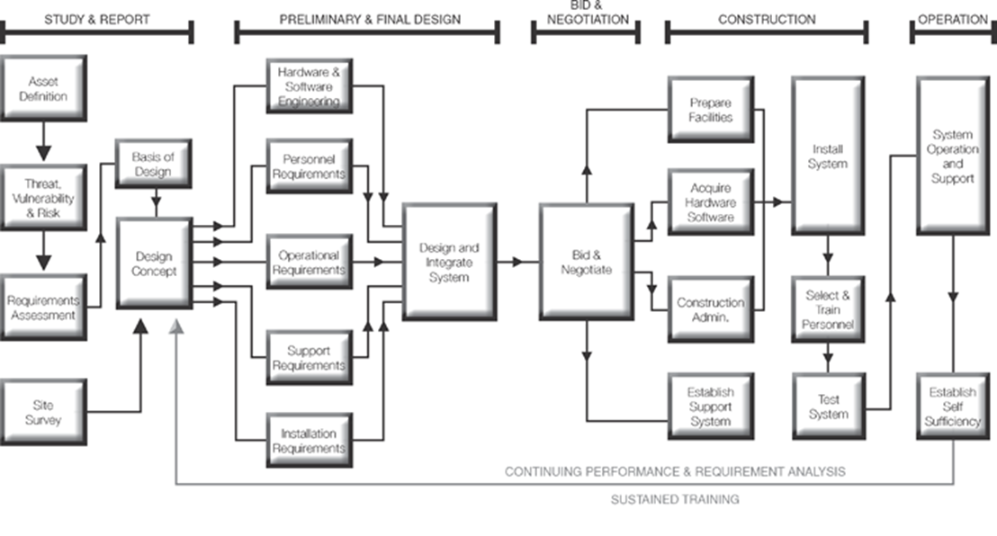
Fundamentals of System Design
Study & Report
Preliminary & Final Design
Bid & Negation
Construction
Operation
Notes:
The process of designing a system is process based with 5 sequential phases. Each phase must be done in turn, as the information that is gained in one is fed to the other.

Slide 30
Key ingredients in planning
Multidisciplinary Approach
Time & Effort
Relevant RISK and ASSET info
Notes:
At the outset of the design phase (study and design phases) we need to ensure that we include three pillars;
We need to look at the problem and potential solutions with an multi or intradisciplinary approach
Second – the planning process takes time and effort, and it must be so. This cannot be done as an afterthought, as the amount of energy invested at the outset will be determinative of the success of the program
All decisions taken must be done so after careful Risk Analysis, asset review and environmental understanding.
It may be useful to set a goal statement of the overall objective and mission of the Integrated Security System (ISS).
It is useful to make determinations about which aspect of the PPS is intended to respond to each of the 3D’s

Slide 31
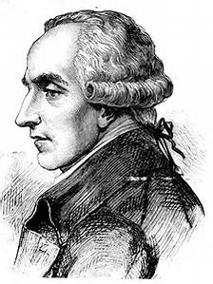
History Lesson
Marquis de Laplace
French mathematician and astronomer :
Developed the 10 principles of probability
The importance of having a redundant security system
Notes:
Laplaces formula states that when events are independent of each other, the probability of their simultaneous occurrence is the product of their separate probabilities.
How is this useful? Because one system may be circumvented, but LOTS of them will unlikely be circumvented. As such, it is best to develop a system that has purposeful redundancies.

Slide 32
Designers: Four Principal Security Strategies
Prevention
Detection
Control
Intervention
Homeland Security: Five Principal Security Strategies
Prevention
Detection
Preparation
Response
Recovery
Notes:
The 3 or 5 D’s are applied to security design as
Prevention (deter) – Detection (detect) – Control (delay) – Intervention (destroy)
The system components should Deter – Delay and Detect
The program as a whole should
Deter – Detect - Delay – Detect –
And importantly, you want to apply the information that you took from your security and risk assesments and design a system which will provide countermeasures to the threats which you identified.

Slide 33
Design Criteria
Codes & Standards – Fire & Life Safety
Quality
Capacity – 10% - 15% Spare capacity
Performance
Features
Cost - Budget is part of Design
Operations
Culture & Image
Monitoring & Response – Small & Medium sites can go to a Central Station / Large or complex sites have a Security Operations Center
Notes:
Okay, so now that you’ve set out the strategy, understand the risks and vulnerabilities and have time to do the work…some things to make sure to build into the design.
Make sure that you call out any specific codes which you are requiring must be met. In addition, you may have some requirements like colors or paint, warranty, equipment manufacturer, or minimum requirements for Pxf or recording.
Obviously better quality equipment produces a better quality end result. A good design should balance quality with the budget, but should do it consistently. Don’t spend $500 on a lock for a $100 hollow core door.
Access control, NVR, storage are expensive. But adding a little bit more after its already installed is a LOT more expensive plan to provide for an appropriate expansion capability
You should call out the specific performance requirements. For example, the NVR must use the current LAN, or access control must be able to process 250 cards per 15 minutes, or the cameras should be able to capture the scene with 1 lumen of light.
If you want optical turnstiles, be specific. Analytic vs Analog, low light etc.
A good program is expensive. Do your studies, make sure you understand the risks and match the budget to the risk
Make sure your perfect program doesn’t interfere with the operations of the business. Consult with the team to ensure that the flows of access make sense
The program must align with the image – hard uniforms, polo shirts – alarms, optical turnstyles, bag checks, etc
Think about how all of this information will be processed and responeded to.

Slide 34
Design Team
CEO
CFO
HR Manager
IT Manager
Facilities Manager
Project Architect
Construction Manager
Security System Designer
Security Manager
Notes:
To make things go smoothly – you’ll need to load the boat

Slide 35
Bid package development and evaluation process
Procurement Types
Sole Source Procurement
RFP – Request for Proposal
IFB – Invitation For Bid
Notes:
Sole source – one company does all the work. This is normal/common/okay for projects which require one type of system. But the downside is that the focus is exclusively on only one system, technology and may skip the thinking about the overall security scope or needs.
RFP – typically based on a specific set of requirements, but may leave brands up to vendor. Should take about 3-4 weeks to provide a full cost proposal
IFB – usually fully spec’d and the award goes to the lowest bidder 2 week turn around

Slide 36
Budgetary projection development process
Preliminary Cost Estimate:
The budget should be within 15%- 20% of final bid prices
Include:
Capitol Project
Service Projects
Recurring Costs
Notes:
The initial conceptual design can provide enough information in order to receive an order of magnitude quote. That is a preliminary estimate but it shouldn’t bee too far off the initial estimate.
While the initial bid may only provide the capital expense it’s important to understand the cost of maintenance, service, software upgrades etc.

Slide 37
Vendor Selection
Compare life cycle costs
Check for large discrepancies
Company reps (good chemistry, competence, trouble shooting)
Reasonable profit will make for a better relationship
References, licenses and credentials
Notes:
It’s typical to charge 11% of capital cost for warranty and maintenance.

Slide 38
Installation and Operation
Do a walk to confirm the locations
Inspect and test all current equipment
Downtime
Follow installation standards
Periodically review
Ensure staff is trained
Notes:
The PM and the contractor should walk the site to ensure that there are no issues or confusion about the locations or requirements for each piece of equipment
If any piece is going to be integrated ensure that the contractor tests it prior to integrate them to the new system
If electricity or web will be shut down, ensure that everybody is coordinated to prepare for the outage
Different system types have different applicable standards the NFPA 731: Standard for the installation of Electronic Premises Security Systems should be followed – ensure that the right type of enclosures are used dependent on interior/exterior and weather appropriate
Appropriate conduit, grounding, each component has it’s own specific requirement (for example on cameras ensure that the power and lines are connected, set the lenses to the right settings, aim it correctly, -
Confirm that the system still meets the need, that the settings are as designed, that all components are functioning
TRAINING (labor technology) – access control, cctv (video retrieval) diagnostic some basic troubleshoot and expected responses

Slide 39
Cost Benefit
Does the risk avoided outweigh the cost of the program
Did you reduce cost with system efficiencies
Insurance claims
Notes:
Insurance – having proof of an incident or the damage done or not done

Slide 40
Assess the effectiveness of physical Security measures : 33%
Protection of personnel, technology and processes
Audit and testing techniques
Preventive and corrective maintenance for systems
Notes:
This task has 3 sub tasks which means 13 minutes per sub task -

Slide 41
Types of Systems Tests
Pre-delivery or factory acceptance tests
Site acceptance test
Reliability or availability tests
After-acceptance tests

Slide 42
Personnel, equipment and processes
Video Systems – object classification, lag time, 24/7 operation, field of view, sensor integration
Lights – are to standard
Entry Control – are there redundancies
Notes:
some basic examples of feature and performance based testing:
Entry control – will the entries and exists be under cctv, are there requirements for the local masking of sensors, electricity issues (connections, availability, ability to impede). How many attempts are allowed before it triggers an event?
Preventative maintenance and who will manage the administration
Does it properly direct the flow of movement and restrict unauthorized movement?

Slide 43
Audit and testing techniques
Analysis: The evaluation of the PPS compared to threats and asset value (not the overall risk analysis that is also done).
Analysis of the PPS
It establishes the assumption under which a design was formed
It relates system performance to threats and assets, making possible a cost-benefit decision.
Notes:
Analysis: The evaluation of the PPS compared to threats and asset value (not the overall risk analysis that is also done).
When testing the system’s effectiveness you can use qualitative and quantitative PERFORMANCE based analysis tools, a CARVER analysis, Adversary Sequence Diagram, path analysis, a neutralization analysis to determine if the system is working as intended. We will go into each of these in more detail during the Physical Security Principles and Practices section
You can also test for features.

Slide 44
PE = PI x PN
PE: Physical protection system effectiveness
PI: Probability of interruption
PN: Probability of neutralization

Slide 45
Qualitative Analysis
Detect an adversary
Timely and accurate alarms
Timely distribution of alarm to responders
Does it address 3 D’s
Detection before delay?
Is the delay sufficient?
Protection in depth
Balanced protection
Engage adversaries
Path/Scenario Analysis
Notes:
When determining if the system is adequate to the job you can look at a number of indicators:
Does your system allow you to detect an adversary with sufficient time to respond?
If the frequency of nuisance alarms low enough to keep the system effective?
Does the alarm get to the right people fast enough?
Think about each feature – does it deter? Detect? Or delay? Does it do so in all types of weather?
Does the delay happen AFTER the detection?
Does it provide sufficient time for the security team or system to respond to the threat?
Is there a single point of failure? Or are there multiple alerts / barriers/ delays
Is there a sufficient balance of protection (all paths have roughly the same effectiveness)
If it’s appropriate – does your system allow you to engage with the adversary to neutralize him
Conduct your path and scenario analysis and see if the systems are effective at closing the gaps

Slide 46
After-Implementation Testing
Operational tests
Performance tests
Post maintenance tests
Subsystem tests
Limited scope tests
Evaluation tests

Slide 47
Preventive and corrective maintenance for systems
2 Main Types of Maintenance
BOTH are normally included in a service agreement
Preventative
Remedial
Notes:
Your systems will stay working optimally if you keep them maintained.
Make sure that you have a contract which provides for service and for preventative maintance -

Slide 49
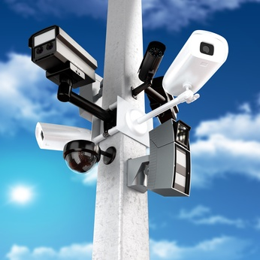
Physical Security Equipment
Sensors
Video Systems
Alarms
Entry Control
Barriers
Lighting

Slide 50

Sensors

Slide 51
Interior Sensors
Passive or Active
Volumetric or Line detection
Application
Covert or Visible

Slide 52
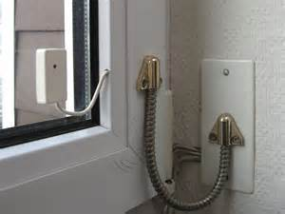
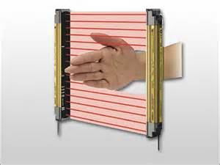
Passive or Active
Passive
No signal from a transmitter
Energized near sensor
Active
Transmitter & Receiver
Detect change or deflection of signal

Slide 53
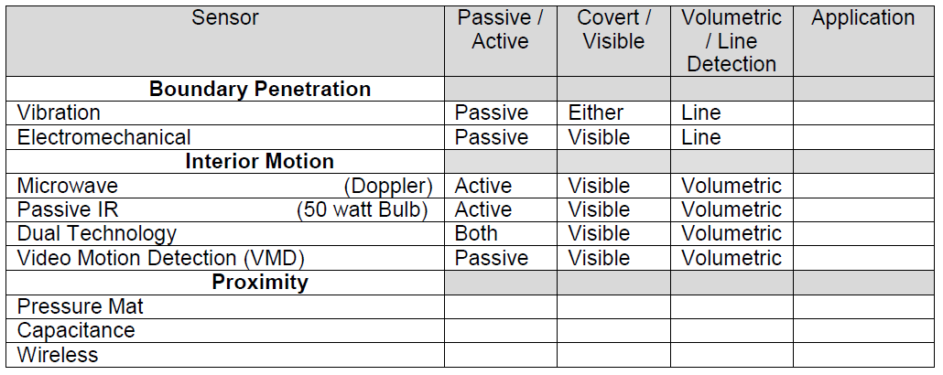
Interior Sensors

Slide 54
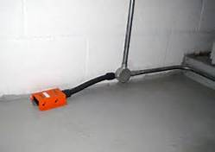
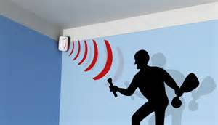
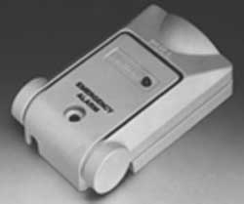

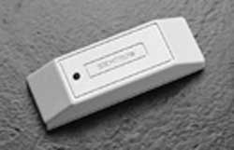
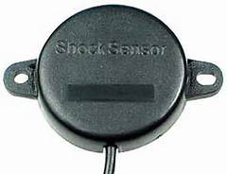
Interior Sensors
Volumetric
Sensor
Water Sensor
Pressure Mat
Sensor
Panic Sensor
Vibration Sensor
Shock Sensor

Slide 55
Sensors: Definitions
Volumetric
Entire room covered by MOTION
Line Detection
Narrow area covered
Electromechanical
Switch installed on doors and windows typically using a magnetic design
Ultrasonic – Transmit in the Ultrasonic range
When the received signal changes from it’s expected level (due to sound deflection or absorption), an alarm is transmitted.
Not recommended in areas with draft or change in humidity
Microwave System – pattern of radio waves that are transmitted and partially reflected back to the antenna

Slide 56
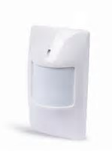
Interior Sensors: PIR
Passive Infrared Sensors (PIR)
Are visible and volumetric
Respond to changes in the energy emitted by human
Equal to heat of 50-watt bulb
Also detect changes in the background

Slide 57
Interior Sensors: PIR
PIR - Advantage | PIR - Disadvantage
Totally passive technology | Moderate vibration sensitively
Well define detection zones | Sensitivity variation due to room temperature
No interaction between multiple devices | Line-of-sight operation with easily blocked field of view
Low to moderate cost | Potential nuisance alarms from rapid temperature changes
Relatively few nuisance alarms | ---------------------------------

Slide 58
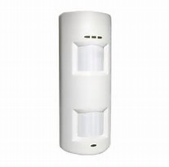
Interior Sensors: Dual Tech
Active and passive, visible and volumetric.
Achieve alarm confirmation while maintaining a high probability of detection.
Combine two technologies, such as microwave and infrared sensors.

Slide 59
Interior Sensors: Video Motion
Video Motion Detection (VMD)
A passive sensor that processes the video signal from a CCTV camera
Factors should be considered when selecting VDM:
Consistent controlled lighting with no flickering
Camera Vibration
Objects that could cause blind areas
Moving objects, such fans, curtains, and small animals
Changing sunlight or shadows

Slide 60

Interior Sensors: Best Practices
Audible or visible alarm indicator that can be recognized from a distance of 10-35 ft.
All sensors should be performance tested after maintenance
Installation and maintenance of sensor should be performed at least to the manufacturer’s specifications

Slide 61
Exterior Sensors
Passive or Active
Volumetric or Line detection
Application
Covert or Visible
Line of Sight-Sensor or Terrain Following

Slide 62
Exterior Sensors
Covert: hidden underground or in something
Visible: attached to a fence or structure being detectable
Passive sensors
Detect energy by an object.
Detect a change in a field of energy
Safer in environments that contain explosives vapors or materials.
Active sensors typically contain both transmitter and a receiver.
Line of Sight-Sensor or Terrain Following
Require a clear LOS

Slide 63
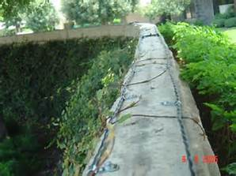
Exterior Sensors
Terrain following Sensors- Where terrain is flat
Requires extensive site preparation
Volumetric Sensor = Alarm when an intruder enters the detection volume
Line Detection = motion along a line
Buried line
Fence associated
Free standing

Slide 64
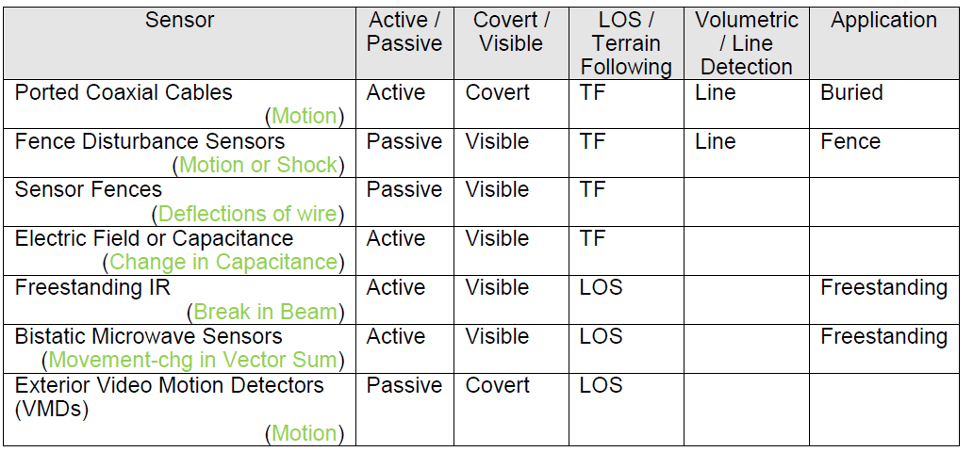
Exterior Sensors

Slide 65
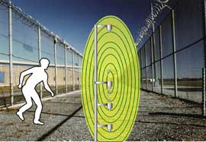
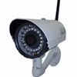
Exterior Sensors: Best Practices
Protection–in-Depth
At least two continuous lines of detection should be used in high security systems.
Complimentary Sensors
Priority Schemes
Combination of Sensors
Sensor Configuration
Clear Zone (Also called “Isolated Zone”)
2 Parallel fences around perimeter
Detection zone is in between fences
Increases detection probability; reduces nuisance alarms, and prevents defeat.
Used at High Security faculties (i.e. prison, nuclear)

Slide 66
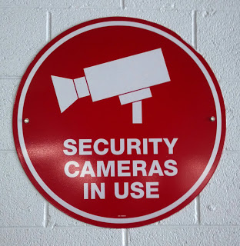
Video Systems

Slide 67
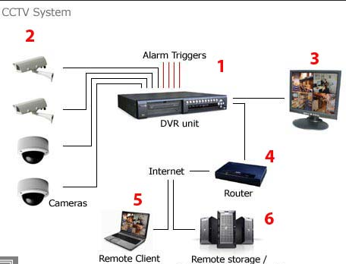
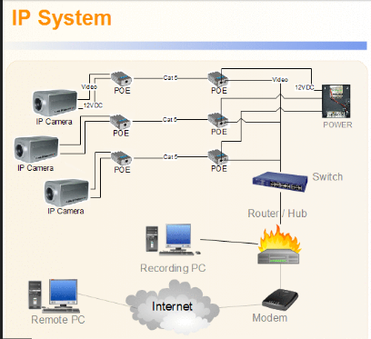
Camera Systems
Analog System
Digital System

Slide 68
Camera Systems: Recorders
Basic types of recorders
Digital video recorders (DVRs) (analog)
Capture analog signals and convert them to digital formats
Network video recorders (NVR (digital)
Designed to accept either digital or analog signals from the filed.
Server/Cloud applications (digital)
Used for large systems, or for systems requirement sophisticated software or analytics.

Slide 69
Camera Systems: Resolution
5 Px/ft
General: clothing & colors not distinguishable
7 Px/ft
Monitor: general human or vehicles, traffic flows
11 Px/ft
Detect: but not identified
18 Px/ft
Observe: clothing & colors start to become distinctive
35Px/ft
Recognize
ID known individuals
46 Px/ft
Subject ID beyond a shadow of a doubt
70 Px/ft
License plate
88 Px/ft
Facial recognition

Slide 70
Camera Systems: Types
Analog
IP
Infrared
Thermal

Slide 71
Camera Systems: Field of View
Target
Activity
Purpose

Slide 72
Camera Systems: Recording
Resolution
Length of Storage
Frames Per Second
Compression Type (codec)

Slide 73
Camera Systems: Technology
Motion Detection
Access Control Integration
Intelligent Video Analytics
Object ID

Slide 74

Camera Systems: Legal
Placement
Bathrooms, places where there is an expectation of privacy
Application
microphones

Slide 75

Alarms

Slide 76
Alarm Systems
AC&D: Alarm Communication and Display
Transportation (or communication) of data
Presentation or display of that data to a human operator in a meaningful manner

Slide 77
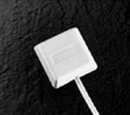
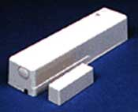
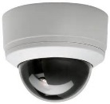
Alarm Systems
Loop
Point-to-Point
Multiplexing
Panel
Panel
Panel

Slide 78
Alarm Systems: Best Practices
Line Protection:
Physical protection of wires: buried or in conduit
Line Supervision:
Means of continuous checking on line integrity electronically.
Simplest is by using and End of Line resistor and checking for that value.
Higher security methods include quasi-random pulses, minimizing variance, frequency shifting

Slide 79

Entry Control

Slide 80
Access Control
Entry Control: Physical equipment used to control movement of people or material into an area. Performance
Access Control: the process of managing databases or other records and determining the parameters of authorized entry (who, what, where, when).

Slide 81
Access Control: Threats
False pretenses to gain entry
Deceit
Use of tools to force entry
Forge a credential, guess a PIN or obtain another person’s credential
Technical Attack
Direct Physical Attack

Slide 82
Access Control: Types
Entry Types
PIN
Tokens (Credentials)
Photo ID
Coded Credential
Biometrics
Personnel Entry Control Bypass

Slide 83
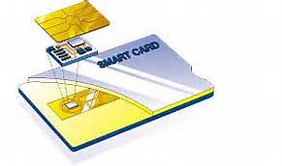
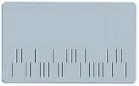

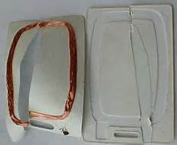

Access Control: Cards
Mag Stripe - easy to decode
Wiegand – wires in card
not used any more
Protocol is industry standard
Bar Code – printed on credential / easy to decode unless in 2-D
Proximity –low or high frequency ( 125kHz or 2.5MHz-1GHz)
Smart Card
Imbedded circuit / 8-64 kilobytes / encrypted communications
HSPD12 – Homeland Defense Presidential Directive 12
FIPS 201 – Federal Information Processing Standard
contact & contactless

Slide 84

Access Control: Biometrics
Type I Error (false reject) / Type II Error (false accept)
Hand / Finger Geometry –measures finger WxL and hand thickness
Handwriting –
low security / easy to forge
Fingerprints – compare minutia points (ridge endings) / ultrasound – below surface
Eye Pattern –
Uses a camera 10-12” away
slow – 5-15 seconds
Voice – low security
Face – complicated metrics
camera or thermal image
difficult: varied expressions & lighting

Slide 85
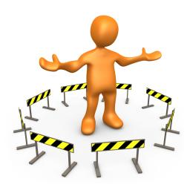
Barrier

Slide 86
Barriers: Access Delay
Principle of Balanced Design: each aspect of barrier has an equal delay.
The more an adversary is delayed, the more time security staff have to assess the situation and send a response force.
Passive Barriers – doors, walls, floors, locks, vents, ducts, and fences
Personnel – security officers, receptionist, concierge
Dispensable Barriers – chemical fogs and smokes, foams, irritants

Slide 87
Barriers
Active dispensable barriers contain:
A process for deciding when to activate
Command and control hardware
Material that is deployed to incapacitate the adversary
A dispensing mechanism
Security officers on-site
Passive dispensable barriers do not have the command and control hardware.
Examples – Rigid foam, stabilized aqueous foam, irritants (pepper mace), smoke and fogs, sticky foam, entanglement devices

Slide 88
Barriers: Examples
Perimeter:
Fences: Rolls of barded tape
Gates:
Vehicle:
Structural:
Walls
Doors
Windows & Utility Ports
Roofs and Floors
Dispensable Barriers
The US Department of State formerly set performance standards for both perimeter and portal vehicles barriers. A new standard is ASTM F 2656-07.

Slide 89
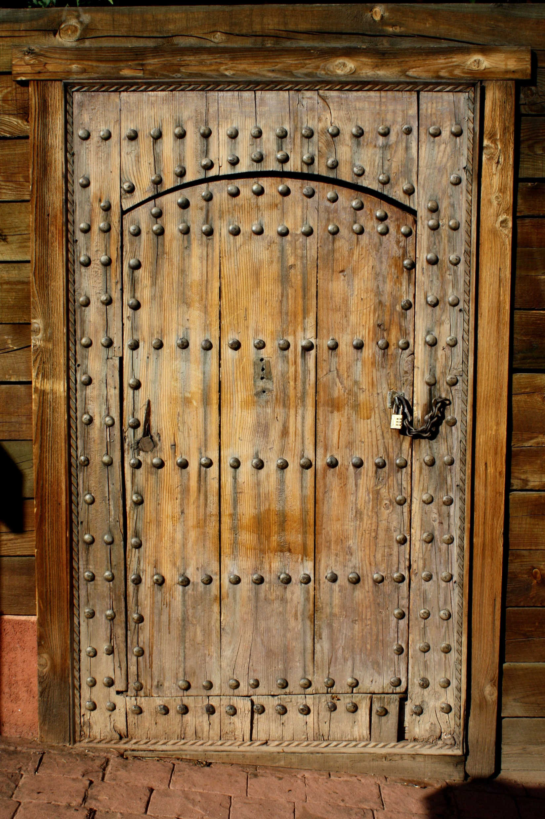
Barriers: Doors
Standard industrial doors
Personnel doors
Attack and bullet-resistant doors
Vehicle access doors
Vault doors
Blast-resistant doors
Turnstile gates

Slide 90

Barriers: Doors Best Practices
The principle of balanced design requires that doors and their associate frames, hinges, bolts, and locks be strengthened to provide the same delay as that provided by floors, walls, and ceilings of the parent structure.

Slide 91
Barriers: Glass
Tempered glass – safety glass
Annealed glass – breaks in to large pieces (Float Glass, rolled, sheet)
Wired
Laminated
Bullet Resistance
Glass/polycarbonate composite glazing contains a core of poly carbonate between the two layers of glass and was developed for prisons.

Slide 92

Lighting

Slide 93
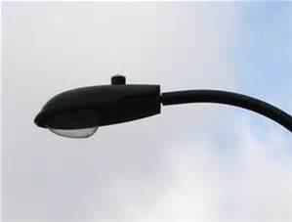
Lights: Basics
A lighting System:
The lamp –(light bulb)
The luminaire –(fixture) is the complete lighting unit
Mounting hardware –wall bracket or light pole,
4. Electric power

Slide 94
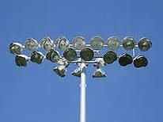
Lights
Continuous – Most Common
Glare Protection – Illuminates the intruder
Standby – Used only when suspicious activity is detected
Controlled – Lights limited space only
Portable Light Systems
Emergency Lighting - Limited to Time of Power Failure

Slide 95
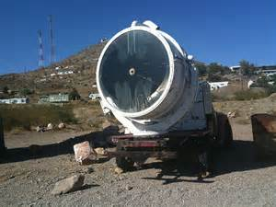
Lights
Street Light
Search Light
Flood Light
Fresnel – Narrow horizontal beam (perimeter)
High Mast Lighting (70ft - 150Ft)

Slide 96
Lights: Basics
The two most important parameters of a lighting system for CCTV: Intensity and Evenness
The quantity of light emitted by a lamp is measured in lumens.
Minimum Intensity
Evenness of Illumination

Slide 97
Lights: Reflectance
Reflectance: The % of light reflected from a scene
Reflectance Measurements
5% = Asphalt
25% = New Concrete
25% = Brick
40% = Old Concrete
40% = Grass
95% = Snow
Color Rendition Index
70-80 = Good
80 + = Excellent
100 = Daylight

Slide 98
Lights
100
Incandescent
75-100
Florescent
70
Mercury Vapor
50
Metal Halide
20 & 5
20 - High Pressure Sodium
Halogen
CPTED Preferred
5 – Low Pressure Sodium

Slide 99
Lights
Ratio of average light to minimum light
1:0.7 = Working Environment
4:1 = Pedestrian Walkway
10:1 = Roadway

Slide 100
Type | Start (Min) | Restrike (Min)
Incandescent | Instant | Instant
Halogen | Instant | Instant
Florescent | Instant | Instant
Metal Halide | 5-8 | 10-20
Mercury Vapor | 5-8 | 10-20
High Pressure Sodium | 2-5 | 1-20
Low Pressure Sodium | 5-8 | 0-8

Slide 101
Lights: Specific Applications
A general rule for lighting level is:
0.5 fc for detection
1.0 fc for recognition,
2.0 fc for identification
5 fc w/ uniformity Rate of 4:1 =Parking structures
(Mcghee, 1988)

Slide 102
Training Topics
System Administration
System Monitoring
Alarm Assessment & Dispatch
Incident Response
System Troubleshooting & Maintenance
IT Functions
System Overview

